Slide 1


Rostering in a pharmacy department
An experiment in workplace rostering using Linear Integer Programming & optimisation modelling techniques

Slide 2



Meet our team
Kipp Hughes
Mathematical Modelling Major
Passionate about education
Active Musician
Chris Swan
Mathematical Modelling Major
Love of problem solving
Creative writer

Slide 3

Our Client
Monash Medical Centre Pharmacy Department
Andrew Chong
Assistant Deputy Director of Pharmacy
Jeff Davies
Senior Pharmacist
Intern Program Coordinator

Slide 4
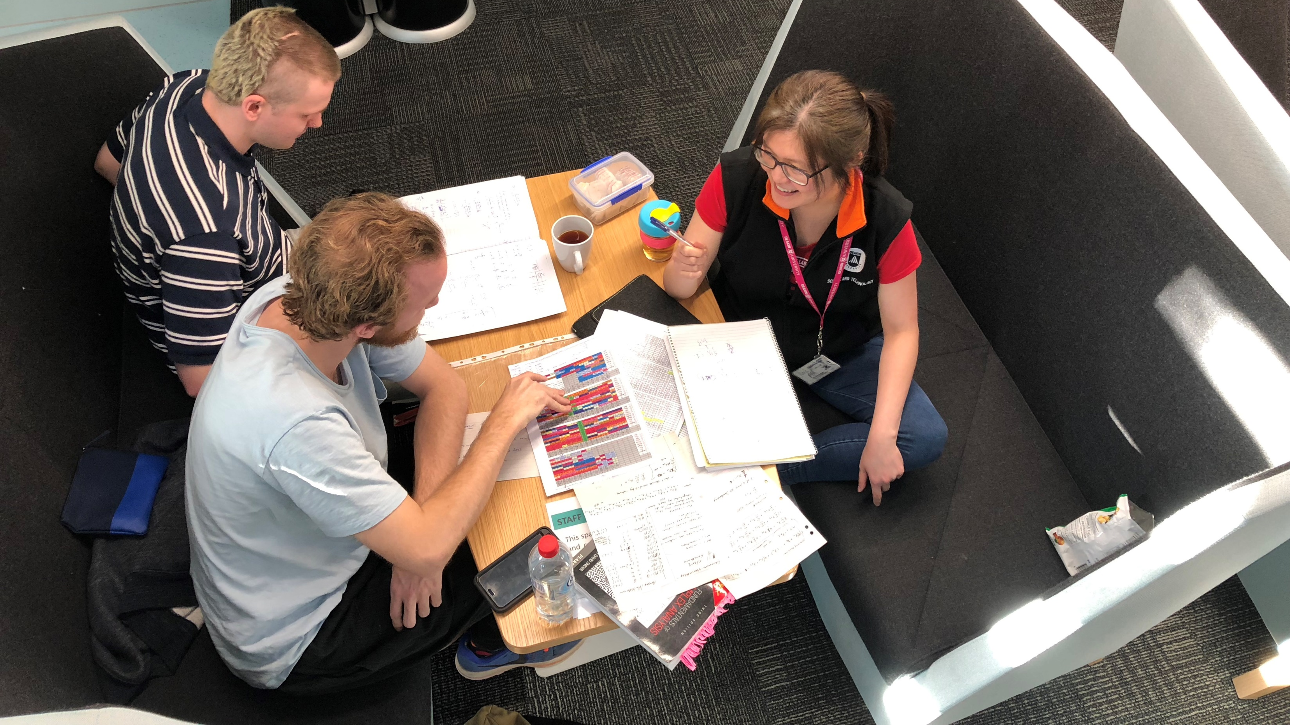
In the beginning…

Slide 5

The problem
Monash Health has 11 interns per year
Required to work in 13 areas across 50 weeks (54 weeks total)
Each area has a fixed amount of weeks for each intern
Each area has a capacity for how many interns can work there per week
Interns get two set weeks of annual leave per year
Image from https://pixabay.com/illustrations/juggle-artists-circus-money-1027141/ - open source

Slide 6
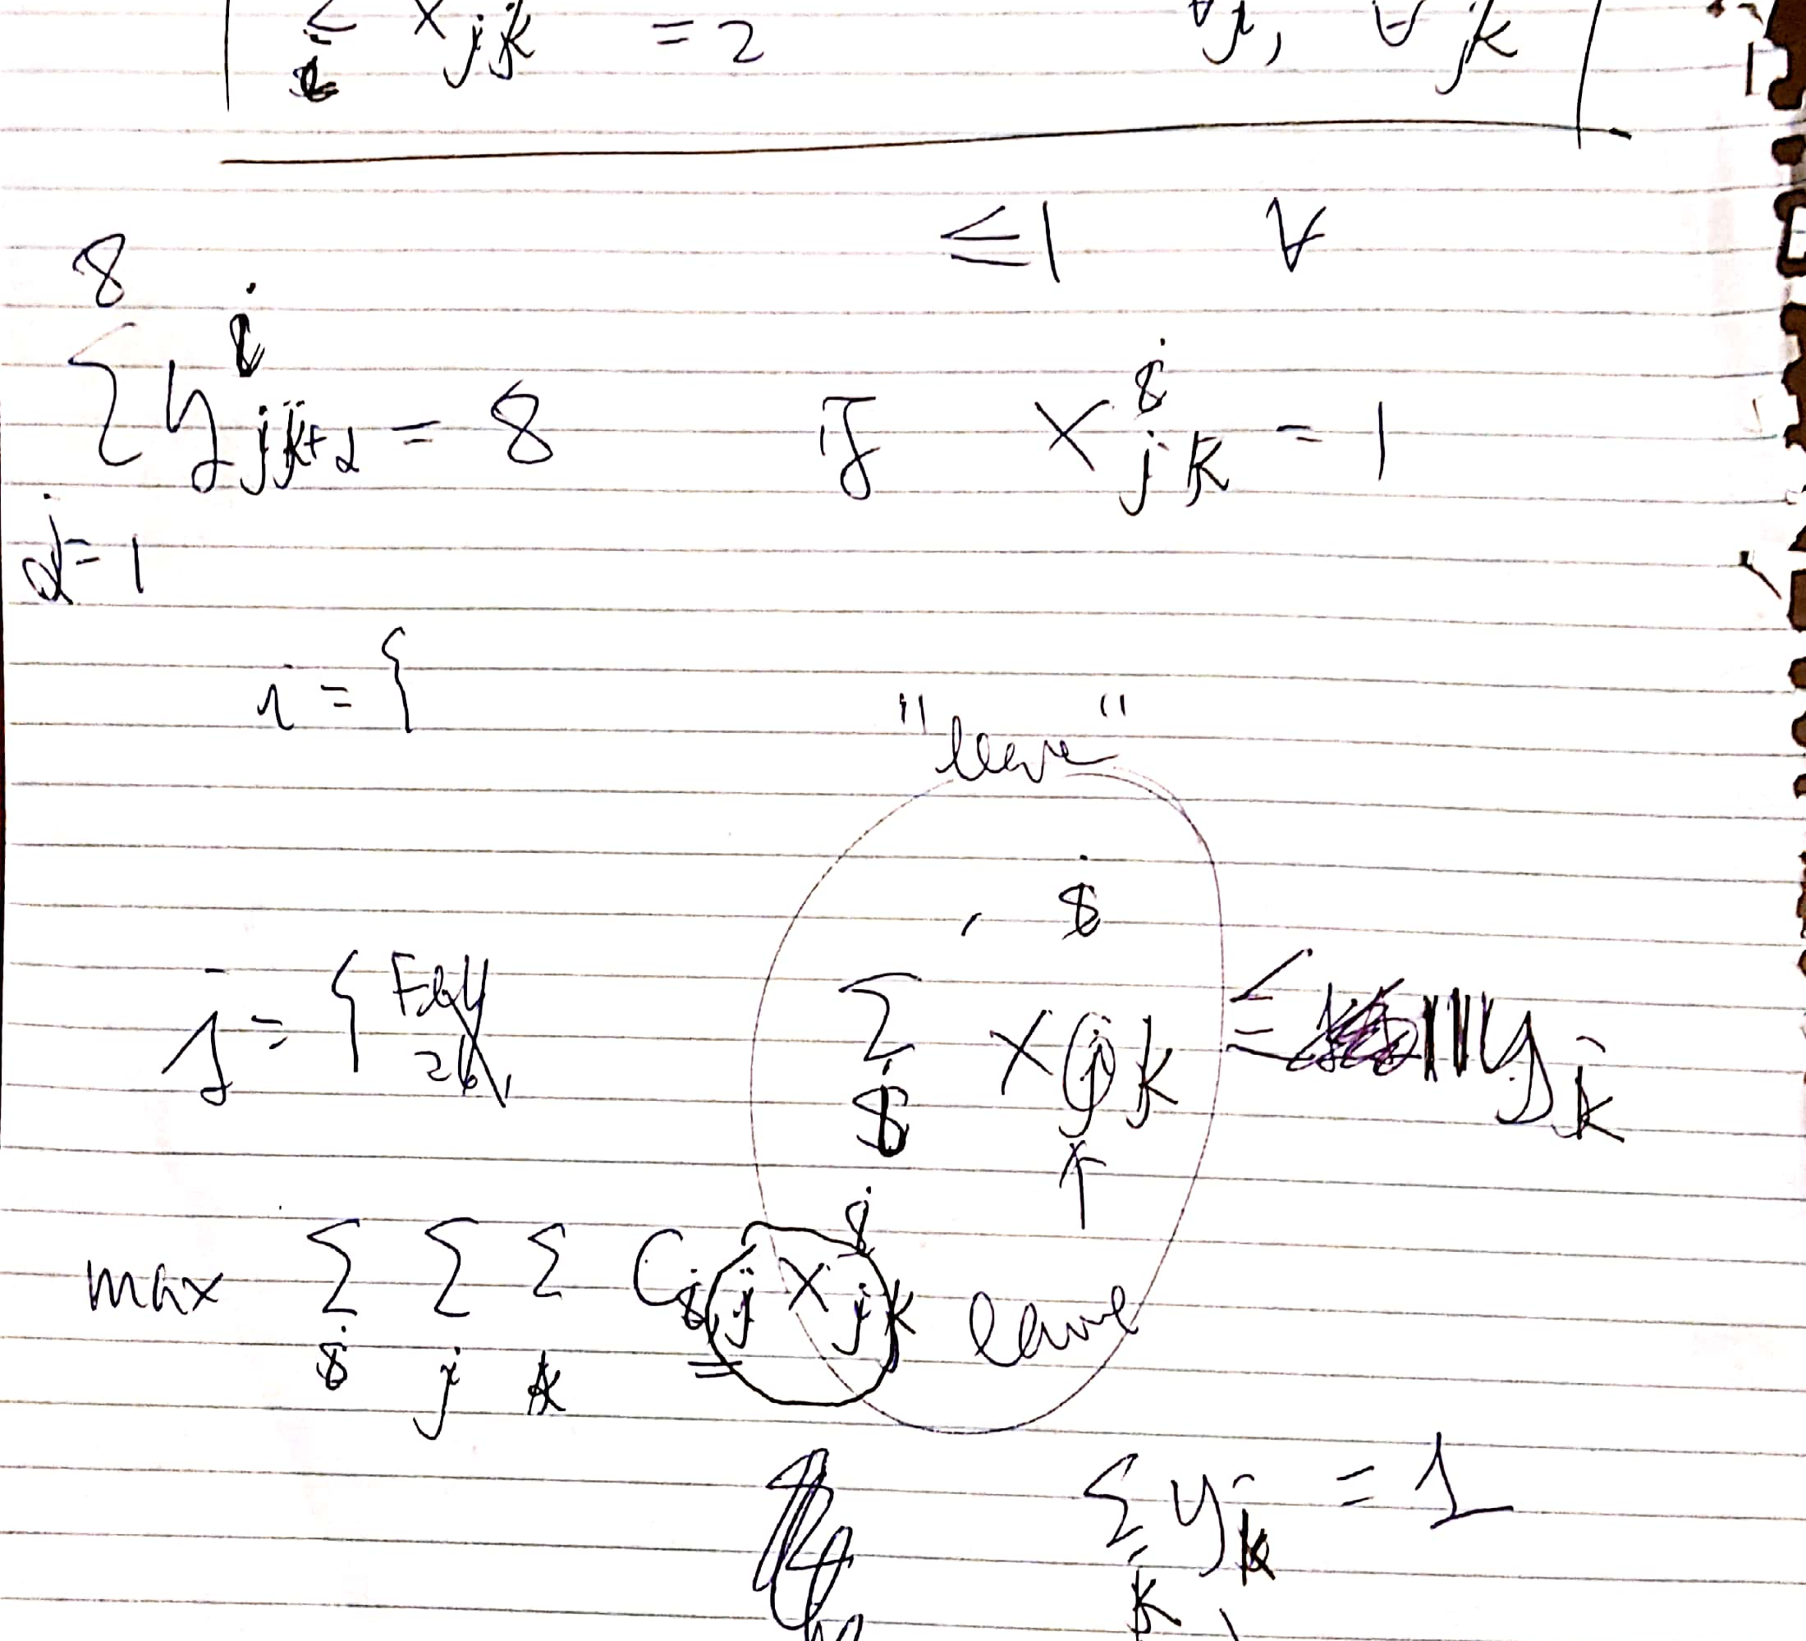
developing the idea
Different ways to approach problems/constraints
Independent development of techniques
Discussion of how to construct the systems of equations required

Slide 7
What is Linear Integer Programming?
Problem solving using systems of linear equations
Expressing problems mathematically
Deconstruct problems influenced by people into abstract reasoning

Slide 8
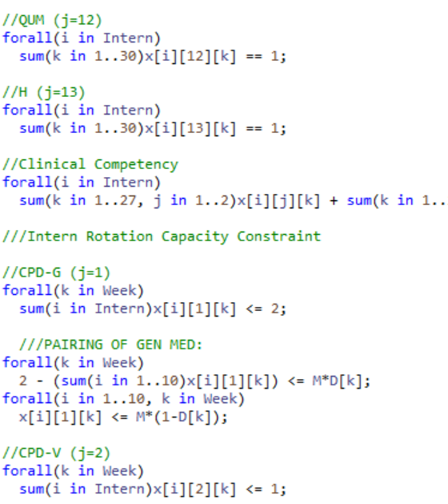

Framing the model
$x_{j,k}^{i}=1$ → intern $i$ is doing rotation $j$ in week $k$.
$\sum_{j=1}^{17}{x_{j,k}^{i}≤1} , ∀_{i=1}^{11} , ∀_{k=1}^{54}$ → Only doing one rotation per week
$\sum_{k=1}^{54}{x_{j,k}^{i}=Z} , ∀_{i=1}^{11}$ → Each intern must complete the set amount of weeks for each rotation
$\sum_{i=1}^{11}{x_{j,k}^{i}≤Z , ∀_{k=1}^{54}}$ → Each rotation has a set number of interns that can work there per week

Slide 9

WHAT DID WE LEARN?
Big M Notation of If-Then Constraints
Ternary Variables
How to negotiate client expectations

Slide 10
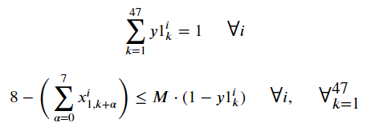
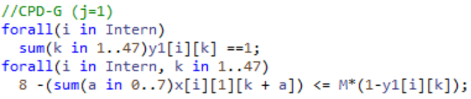
Big M notation
SITUATION: The need to express conditional statements as linear equations
TASK: To develop systems that encompass the ‘blocking’ of rotations
ACTIONS: Experimentation with different formats, research and literature review, previous class notes, expert consultation
RESULT: A comprehensive system for creating duration blocks of rotations

Slide 11
Using ternary operators
SITUATION: The need for a way to tie three factors together
TASK: Develop a method of representing a decision variable with three dependencies
ACTIONS: Initially attempting to multiply two variables with two tuples with each other. Through research and experimentation, we concluding in using a single decision variable with three tuples
RESULT: A simple and relatively concise means of expressing our desired result, the consequence being that the model successful places each intern into an appropriate rotation

Slide 12
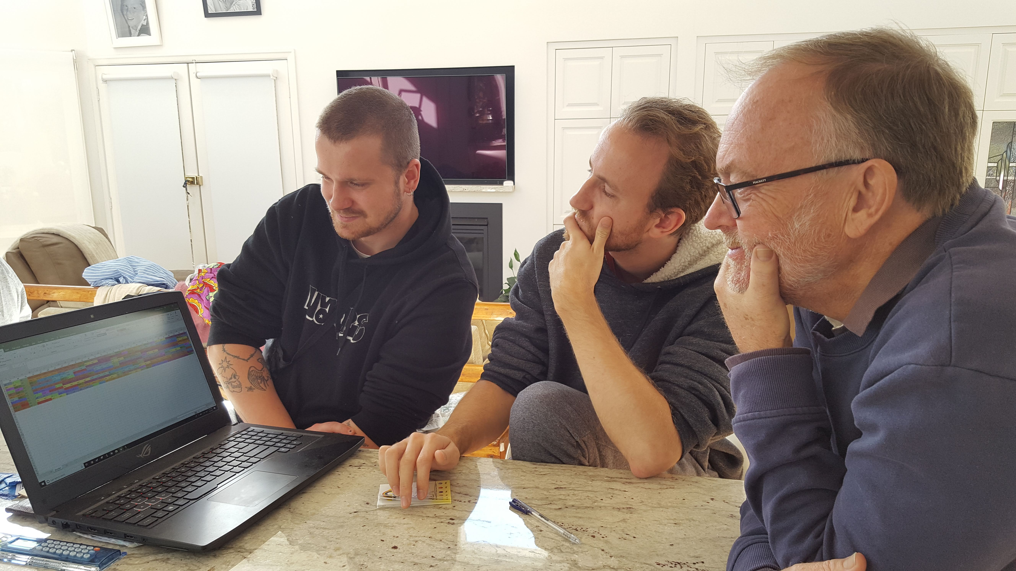
Client negotiation
SITUATION: The need to reconcile the client’s expectations with our model’s limitations
TASK: To deliver a functional and sustainable model capable of producing a roster
ACTIONS: Explanation of processes and limitations, earnest discussion, re-evaluation in conjunction with the client
RESULT: Not only achieving compromise, but a mutual understanding of the client’s needs and of our restrictions

Slide 13
Project outcomes - summary
Successful delivery of a functioning intern roster
Flexibility and capacity for adjustment
Extensive variety of options for the client to choose from

Slide 14
Situation
The objective of developing a computer generated intern roster
The need to be able to adjust to the client’s ideas
The potential to respond to new constraints
An emphasis on continued quality improvement

Slide 15
Task
To create an optimisation model that creates a roster as per the specifications
To achieve an objective of the best fit of interns’ rotations
The aspiration of improving the experience for the pharmacy interns
Achieving an appropriate balance between different forms of rotations

Slide 16
Actions
The development of equations that accurately graph the constraints
Innovating new ways of improving the roster
Troubleshooting the combined model
Testing feasibility
Ensuring the client is satisfied with the product

Slide 17
And the results…?

Slide 18
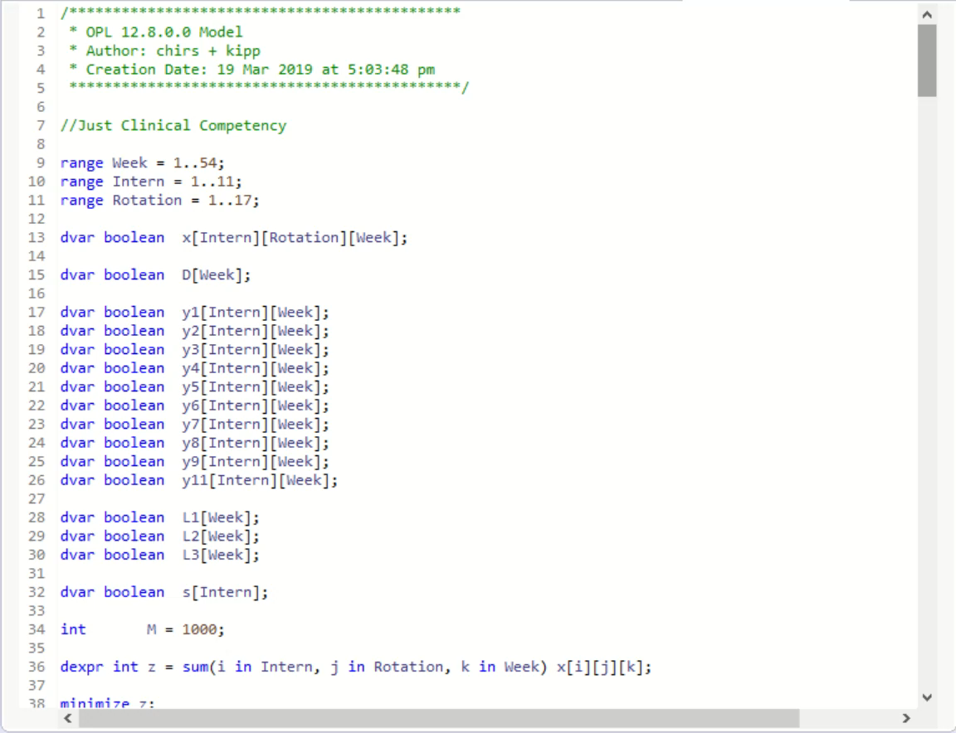
Intern roster Version 8.3
A comprehensive and extensive model
Based on Jeff’s original constraints, with some innovative improvements
A foolproof method of ensuring no intern’s experience lags behind another’s

Slide 19
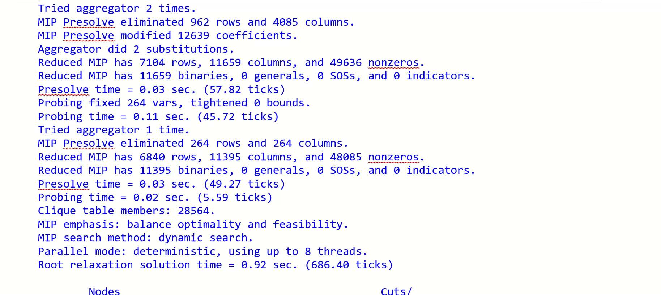
Intern roster Version 7.9

Slide 20
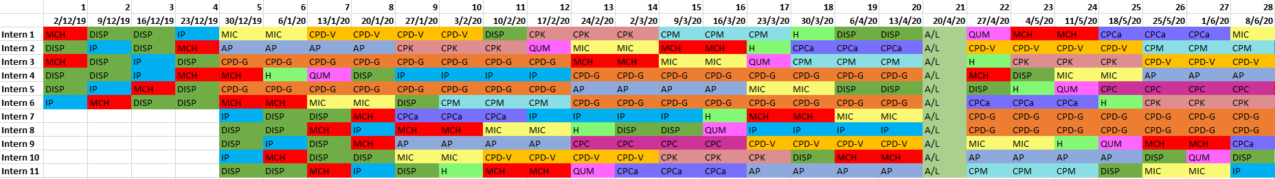
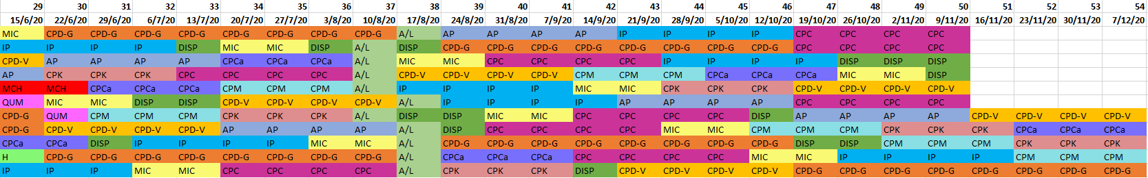
Intern roster version 8.3 - final

Slide 21
references
2015, Pixabay, retrieved 26 May 2019, <https://pixabay.com/illustrations/juggle-artists-circus-money-1027141/>
Rosen K H 2012, Discrete Mathematics and Its Applications, 7th edn, McGraw Hill, New York.
Winston W 1994, Operations Research: Applications and Algorithms, 3rd edn, Duxbury Press, Belmont, California.

